Slide 1
Compact Sensor

Slide 2
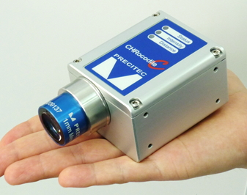
What is the CHROcodile C?
A compact chromatic answer to triangulation sensors.

Slide 3
Comparison to Triangulation
Chromatic confocal VS Classic Triangulation
Surface independent:
Specular surfaces

Slide 4
Comparison to triangulation
Chromatic confocal VS Classic Triangulation
Acceptance angle:
Up to ±45°

Slide 5
Comparison to triangulation
Chromatic confocal VS Classic Triangulation
Various geometries:
less shadowing

Slide 6
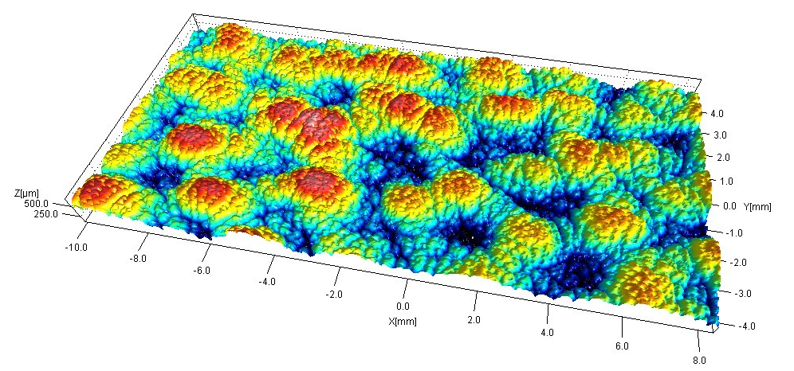
Measuring Examples: CHROCODILE C
Paper Topography Leather Topography

Slide 8
Advantages
Compact and fast with measuring ranges from 200 µm to 25 mm.

Slide 9
Advantages
Up to 4 distances and 3 thickness layers at once.

Slide 10
Advantages
Surface and geometry independent.

Slide 11
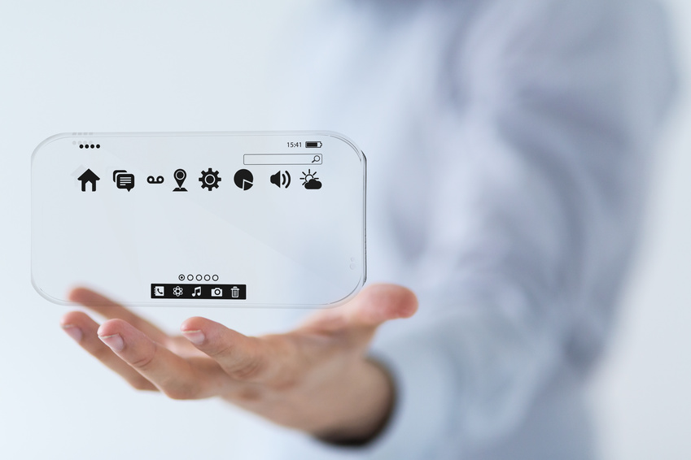
Applications
Consumer electronics
Display thickness
OLED mask inspection
Circuit connection
COG bonding
…

Slide 12
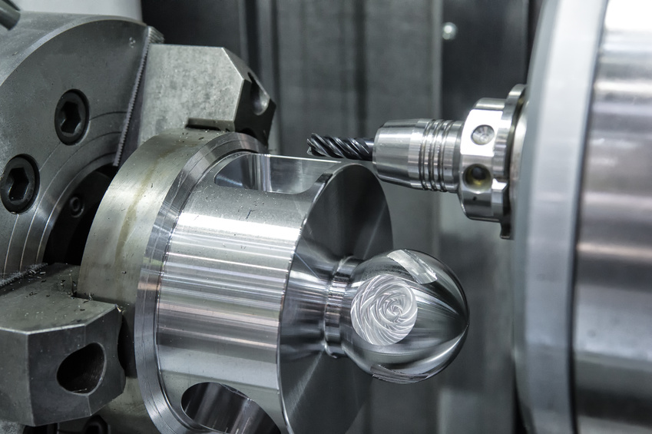
Applications
Mechanics
Topography
3D shape measurement
Curvature and planarity inspection
Roughness measurement
…

Slide 13
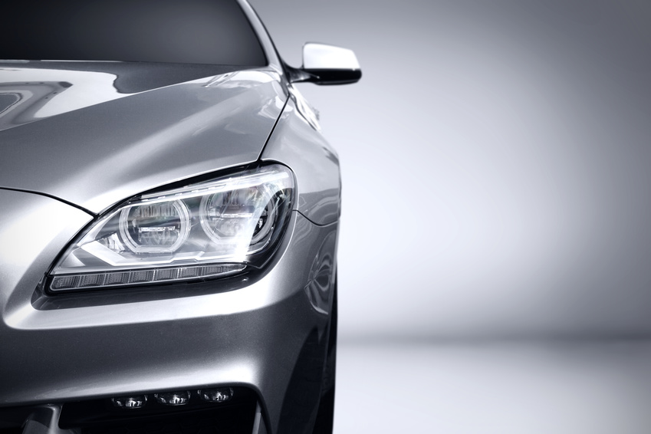
Applications
Automotive
Valve inspection
Car interior
Automotive glass inspection
Airbag seam inspection
…

Slide 14
Please approach us for further discussion!

